Slide 1

FMCG SALES Analytics REPORT
EMPLOYEE RETENTION

Slide 2

Project – 253 F&B Analytics Project Mentor : Mahendra Singh Team Members : Pranjal kumar singh Mamta Tiwari Mohan kholiya Ashitha Renneish

Slide 3






AGENDA
Introduction
Problem Statement
Business Objective
KPIs
Dashboard
Conclusion

Slide 4


Business Objective:
The aim of this project is to analyze sales and attrition rates with the organization and provide insights to the sales team for developing effective profit strategies. Through data analysis and visualizations, we will identify factors that contribute to :
Yearly turnover and attrition.
Evaluate the effectiveness of existing market strategies.
To verify the satisfaction level of customer.
Provide recommendations to improve customer retention.

Slide 5

KPIs stands for Key performance indicators measure a company's success vs. a set of targets, objectives, or industry peers.
Problem Statement:
STATE WISE SALES.
QTD,MTD,YTD.
Brand wise Total Sale.
AM WISE SALES.
Sales Type.
STORE WISE SALES.
MODEL WISE SALES.
SALES GROWTH
YOY Growth, CY, PY.
Average Sales, Total Order.

Slide 6


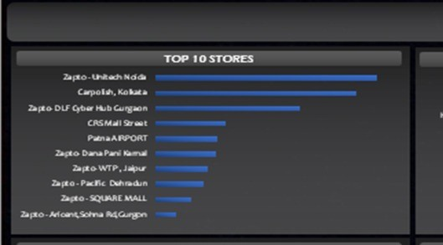


KPI 1 STATE WISE SALES.
This KPI is to find out the Sales according to states.
BY analyzing the data with the help of Microsoft excel . We find that the most valuable state is UTTAR PRADESH with the highest number of sales 22.06M. And the other side TAMIL NADU is in the bottom with the least number of sales.

Slide 7
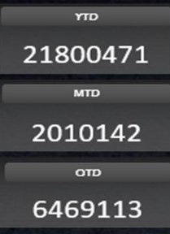
TOTAL SALES(YTD,MTD,QTD)
KPI 2
Year To Date
Month To Date
Quarter To Date

Slide 8
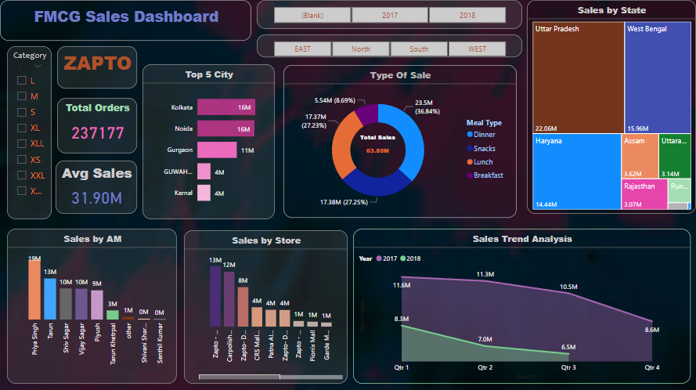
KPI 3 Brand wise Total SALES
After analyzing the data with the help of POWER BI, we have found that the Brand ZAPTO has the Total number of sales approx. 64M.

Slide 9
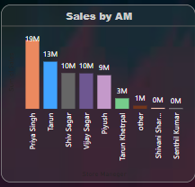
KPI 4 AREA MANAGER WISE SALES.
Based on our analysis and visualization, it is evident that PRIYA SINGH has the highest number of sales with an overall sales of 19m.

Slide 10
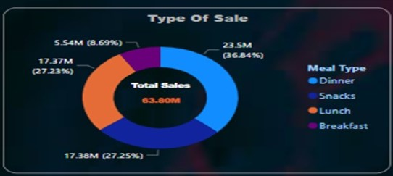
KPI 5 Sales Type.
From this we can see DINNER is at the highest number as compared to the rest and lowest is for BREAKFAST.
From the analysis we can conclude that average sales is approximately 17m for all except BREAKFAST.

Slide 11
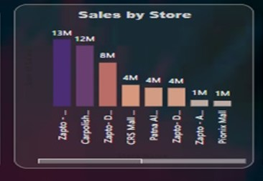
KPI 6 STORE WISE SALES.
Here Zapto - Unitech Noida Stands out with the highest sales about 13M.

Slide 12
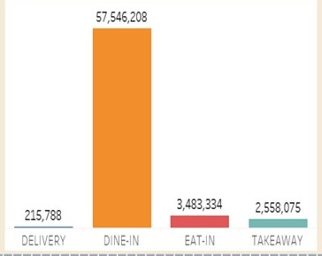
KPI 7 MODEL WISE SALES.
From this we can see DINE IN is highest number as compared to the rest of the models and lowest is for DELIVERY.

Slide 13
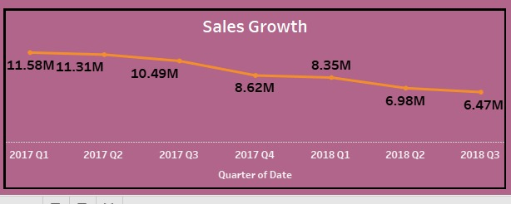
KPI 8 SALES GROWTH

Slide 14

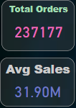
KPI 8 & 9
With The help of Tableau and PBI we get to easily calculate this KPIs.

Slide 15
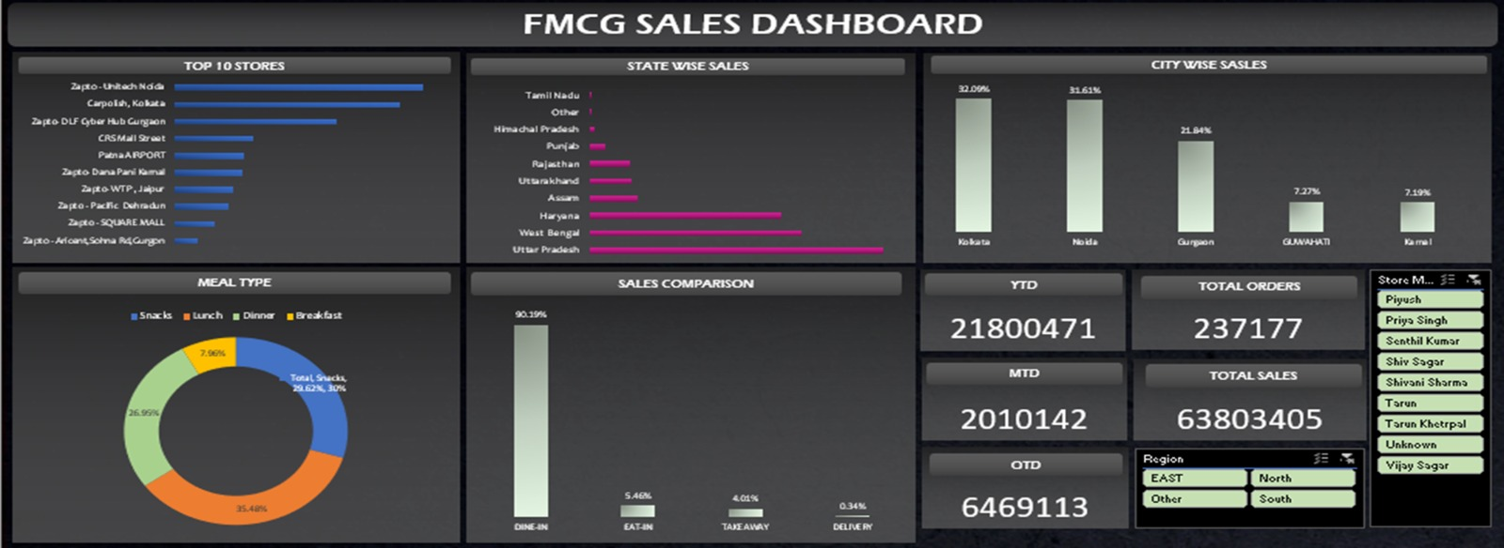
EXCEL DASHBOARD

Slide 16
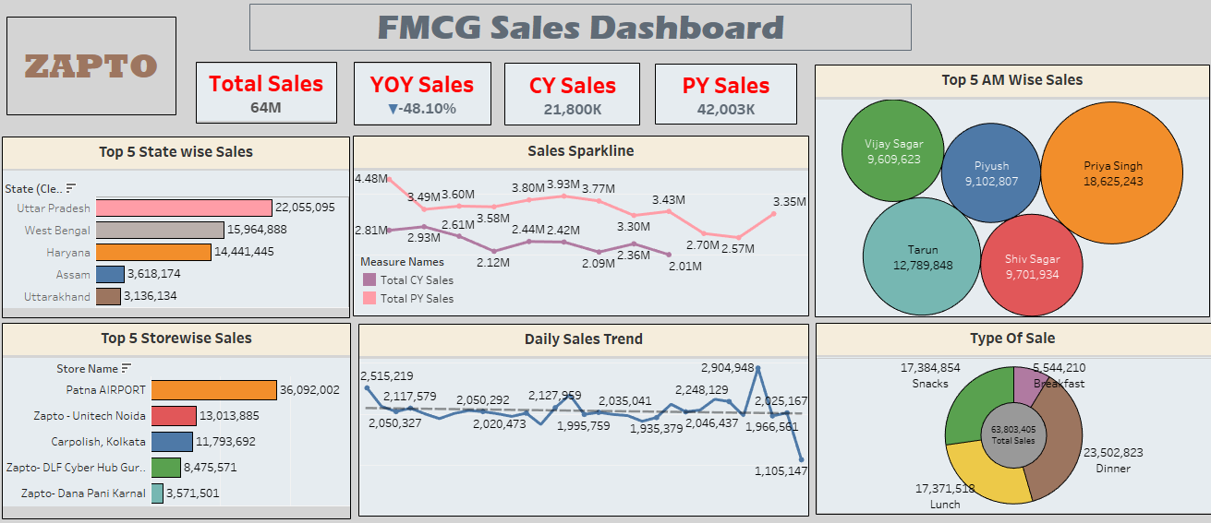
TABLEAU DASHBORD

Slide 17
POWERBI DASHBORD

Slide 18
INSIGHTS
YOY Sales Indicates Zapto sales have significantly decreased by -48.10%.
The Average Sales from the year 2017-2018 is 31.9M.
The Sales are going down from the 3rd Quarter of the year 2017.
Sales are highest in the North, moderate in East and very low in the South and West regions.
People prefer Dining in compared to home delivery.
Meal type preferred is dinner, need to pick up on breakfast.

Slide 19
Conclusion Zapto will have to take various measures which may help it to come up for the final quarter as the sales volume is going down which signifies a warning flag.
KEY INTAKE
To increase sales we can provide them
Coupons/cashback after purchase
Reduce price in lowest sales regions
Membership plans and offers.

Slide 20



